Slide 1
COMMONCRAWL INSIGHTS AND TOPIC EXPLORATION
BIG DATA CS-GY 6513 SPRING 2023
PRESENTED BY :
ANIL POONAI
ARJUN NAGA SIDDAPPA
ROHAN PATEL

Slide 2
INTRODUCTION
01

Slide 3
INTRODUCTION
Internet is huge. There around 1.13 billion websites in the world.
Each of these websites has unique address and have a different content. We were curious as to what topics, the contents of these websites are based on, the most popular websites and the top level domain distribution.
Getting the list of all the websites, loading them and reading them to determine the topics is almost an impossible task.
Commoncrawl data has the raw crawl data, extracted text and metadata for all the publicly accessible websites.
Using Big Data technologies to process this data would help us achieve our goal with practical and reasonable speed

Slide 4
DATA
02

Slide 5
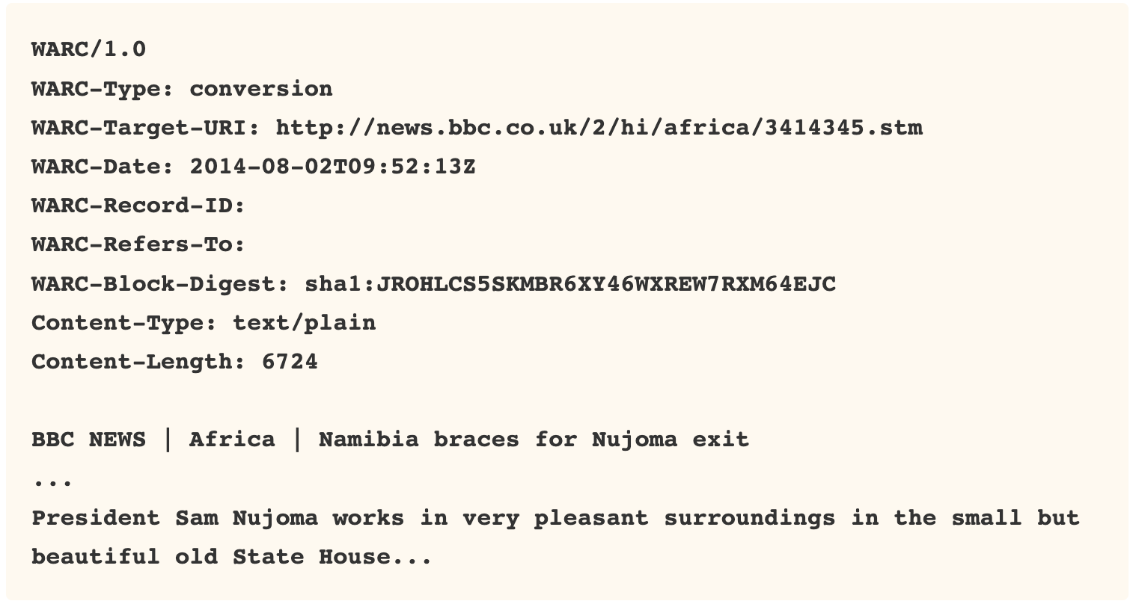
COMMON CRAWL
The Common Crawl corpus contains petabytes of data collected since 2008
It contains raw web page data, extracted metadata and text extractions
The data is segregated monthly. For every month there are around 88000 text files. Each text file containing http requests of several websites
For our project we are processing the files of November-December 2022
A sample of the WET text file is shown alongside:
Link: https://commoncrawl.org/big-picture/

Slide 6
PROBLEM STATEMENT
03

Slide 7
PROBLEM STATEMENT
To set up a pipeline that would be able to process files from CommonCrawl dataset which has petabytes of data and would obtain the following results:
Topic Modeling: To group together websites that belong to the same topic and show why are they so
TLD Distribution: To get the distribution of all the available top level domains
Popularity of websites: To get the list of websites in decreasing order of popularity. Popularity is determined as the amount of times the website has been referenced in other websites.
Since the commoncrawl data is huge. This pipeline must be fast and be capable of operating on a distributed architecture

Slide 8
SOLUTION
File size
Pyspark
Hardware

Slide 9

ARCHITECTURE
05

Slide 10

APPROACH
(2 methods)

Slide 11
EMR and m5.xlarge Config
Applications:Spark 2.4.8, Zeppelin 0.10.0, JupyterEnterpriseGateway 2.1.0, JupyterHub 1.4.1
Release label:emr-5.36.0
Master:Terminated1m5.xlarge
Core:Terminated4m5.xlarge
No task nodes
Scaling was managed and maxed at 4
vCPU: 4
Memory: 16GiB
Instance Storage: EBS only
Network Bandwidth: Up to 10 Gbps
EBS Bandwidth: 4750 Mbps

Slide 12
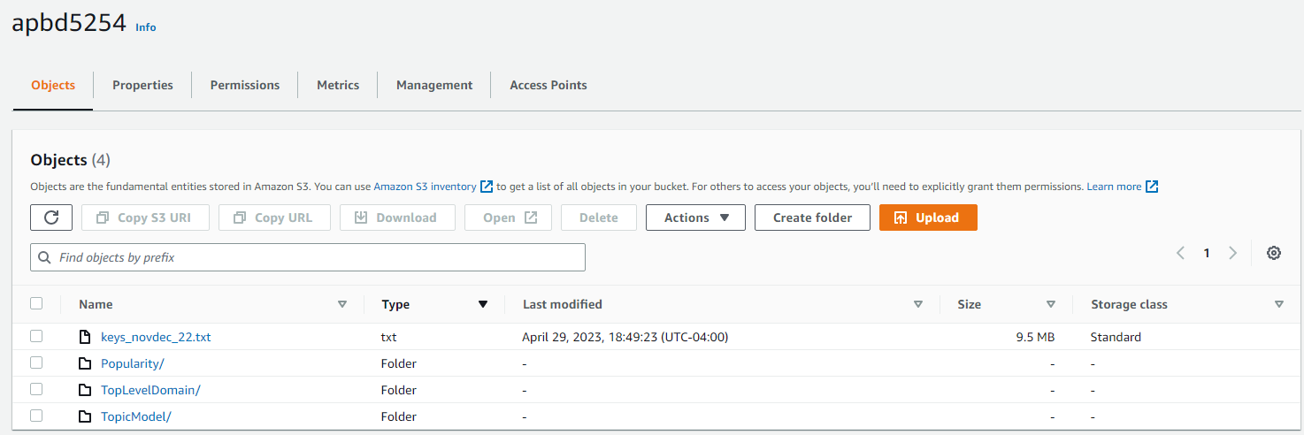
Screenshot of S3 bucket

Slide 13
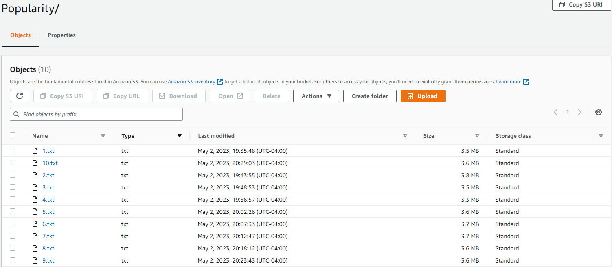
Screenshot of Popularity Results

Slide 14
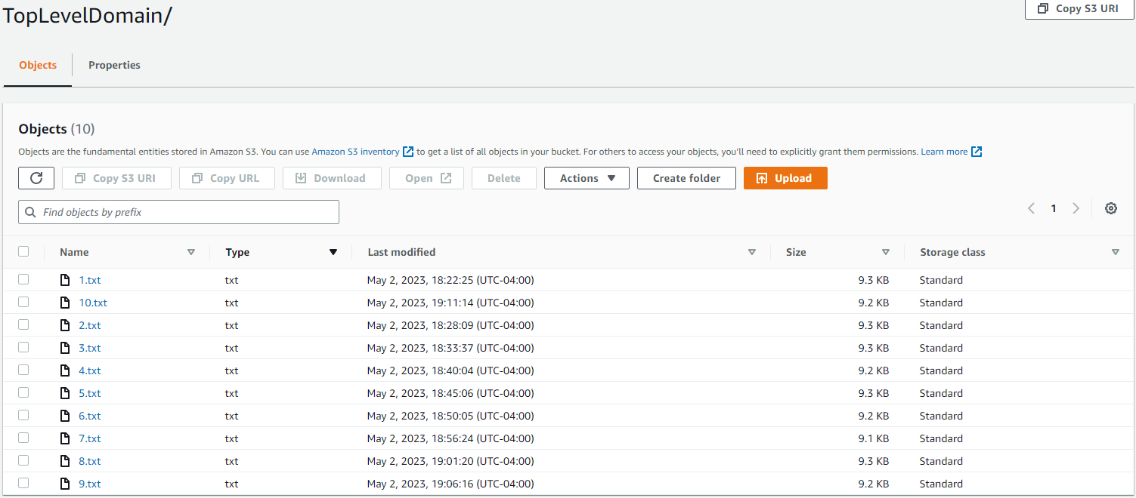
Screenshot of TLD Results

Slide 15
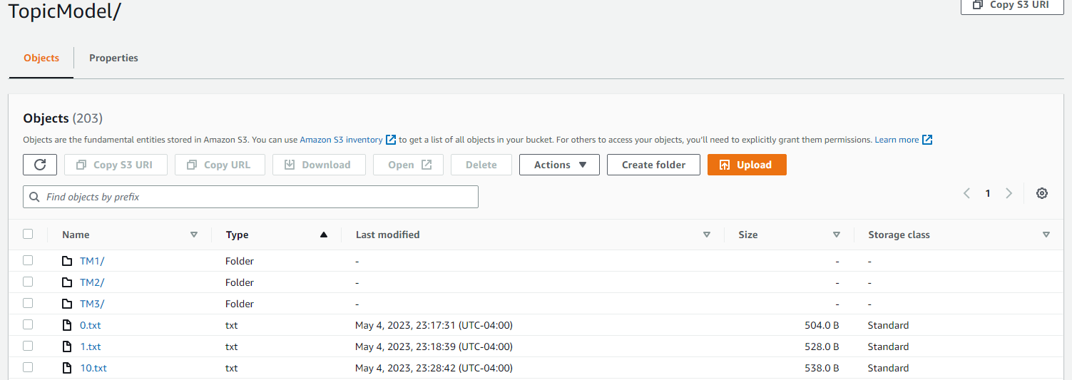
Screenshot of Topic Modeling Results

Slide 16
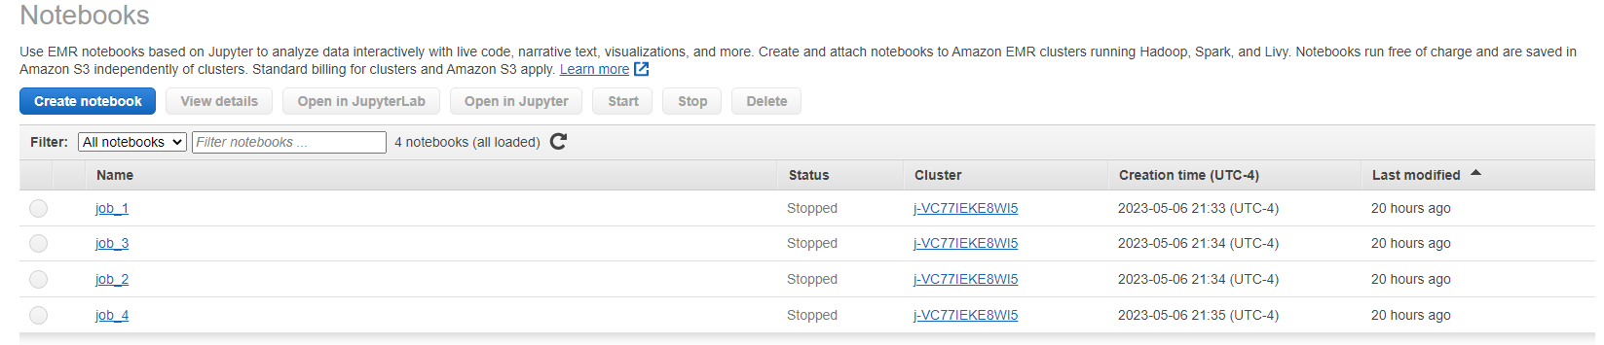
Screenshot of Topic Modeling Jobs

Slide 17
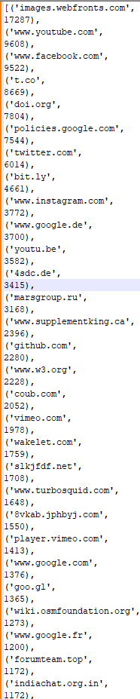
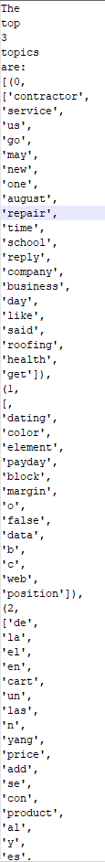
Popularity
Topic Modeling
TLD

Slide 18
Visualizing the results
06

Slide 19

Topic Modeling’s PyLDAvis Result

Slide 20
Visualizing topic modelling using PyLDAvis
PyLDAvis visualizes the corpus extracted from crawl.wet files, revealing key insights:
Intertopic Distance Map: 2D plot with circles as topics; distance indicates similarity, revealing topic clusters and structure.
Circle Size: Represents topic prevalence in the corpus. Topic Relevance: Clicking circles displays top terms ranked by relevance, combining term probability and distinctiveness.
Sliding Scale (λ): Adjusts relevance metric (0-1) for meaningful term identification.
Hovering over Terms: Highlights related topics and displays term frequency/rank.
Tooltip Information: Shows topic number, prevalence, and top terms when hovering over circles.
Adjusting the relevance scale (λ) from 0 to 1 tailors term rankings. λ=1 emphasizes terms frequently used within a specific topic, while λ=0 highlights terms unique or specific to that topic, instead of terms commonly used across multiple topics.

Slide 21
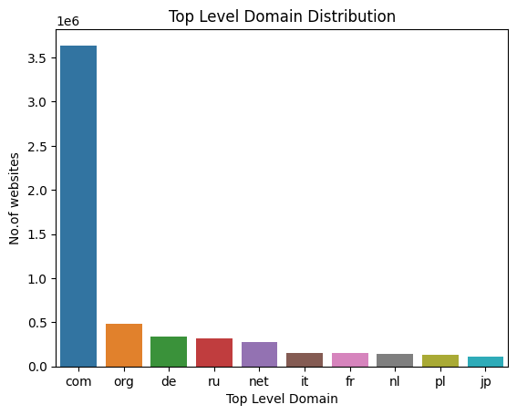
Distribution of Top Level Domains
We can see that there are significantly more number of “.com” websites followed by “.org”
Of the corpus processed, it appears the websites are from Russia and European countries

Slide 22
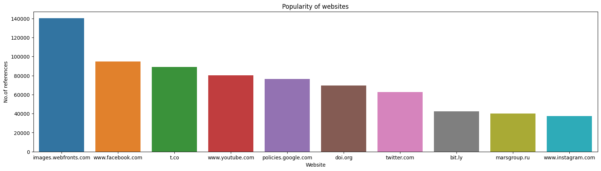
Popularity of Websites
No. of times a particular website is hyperlinked in other websites
“Images.webfront.com” is an image upload and view website popular in Russia
We can see popular social network and social media sites such as Facebook, youtube, twitter and instagram make the top 10 popular websites

Slide 23
CONCLUSION
07

Slide 24
Conclusion
As mentioned before, we would change the way we processed the data, would take advantage of concurrency in EMR
Very possible to implement for entire dataset, can get 1 PiB in ~1000 hours with one of the lower end processing powers
We successfully processed a portion of the data and performed three tasks on it.
We grouped the websites based on how close they are to each other in content thus grouping them into different topics. We used pySpark ML module’s LDA algorithm for topic modeling here.
Upon analyzing the distribution of the top level domains, we can see that “.com” by far is the most frequent TLD used.
Aggregating the count of the number of times a website is referenced, we can see that “images.webfronts.com” a popular image hosting website is the most popular.
We have successfully built a pipeline that’s capable of performing three analytical tasks on a large dataset such as CommonCrawl dataset using Big Data technologies such as pySpark

Slide 25
APPENDIX
DATA:
https://commoncrawl.org/
https://index.commoncrawl.org/
CODE:
https://github.com/DevonARP/Common_Crawl_Big_Data_6613_Project
Algorithm
https://nlp.stanford.edu/events/illvi2014/papers/sievert-illvi2014.pdf
https://towardsdatascience.com/latent-dirichlet-allocation-lda-9d1cd064ffa2

